Slide 1
Lecture 4,5

Slide 2
Program and Network Properties
Fundamental properties of program behavior
Major classes of interconnection network
Computational granularity
Condition for program partitioning
Matching software with hardware
Program flow mechanism
Compiler support for parallelism

Slide 3
Condition of Parallelism
Need to make significant progress in 3 key areas.
Computation models for parallel computing
Interprocessor communication
System integration for incorporating parallel system into general computing environments

Slide 4
Data and Resource Dependences
To execute several program in parallel requires each segment to be independent of the other segment
Dependence graph describe the relation
Node correspond to the program statements
Edge show the ordered relation among statements.
Analysis of dependence graph shows where opportunity exists for parallelization

Slide 5
Data Dependence
Ordering relationship between statements indicated by data dependence
Flow dependence: Statement S₂ is flow dependent on statement S₁ if an execution path exists from S₁ to S₂ and if at least one output of S₁ feeds in as input to S₂. Denoted by S₁→S₂

Slide 6
Data dependence example
S1: Load R1, A
S2: Add R2, R1
S3: Move R1, R3
S4: Store B, R1
S1
S2
S4
S3

Slide 7
Data Dependence (cont..)
Antidependence: S₂ follows S₁ and if the output of S₂ overlaps the input to S₁
Output dependence: if two statement produce or write the same output variable
I/O dependence: Is same file is referenced by both I/O statements

Slide 8
Example
S2 is flow dependent to S1
S3 is antidependent on S2
S3 is output dependent on S1
Not every pair of statement are related (Partial ordering relation)
S2 and S4 totally independent
S1: Load R1, A
S2: Add R2, R1
S3: Move R1, R3
S4: Store B, R1

Slide 9
Example (2)
S1 and S3 are I/O dependent
S1: Read (4), A(I)
S2: Rewind (4)
S3: Write (4), B(I)
S4: Rewind (4)

Slide 10
Control Dependence
The order of execution of statement cannot be determined before run time
E.g. Conditional statement will not resolved until run time
Dependence may also exist between operation performed in successive iteration of looping procedure

Slide 11
Example
For( i=0; i <N ; i++) { A[i]=C[i]; If(A[i]<0) { A[i]=1; } } | For( i=1; i <N ; i++) { If(A[i-1]==0) { A[i]=0; } }
Control Independent | Control Dependent

Slide 12
Resource Dependence
Concerned with the conflicts in using shared resource (e.g. int unit, floating unit, registers, memory etc.)
When conflicting resource is ALU, it is called ALU dependence
Storage dependence
Transformation of sequentially coded program into parallel executable form can be done by explicit or implicit parallelism
The detection of parallelism requires a check of the various dependence relation

Slide 13
Bernstein’s Conditions
Set of conditions which determines which two processes can execute in parallel
Process P₁ and P₂ can execute in parallel if they are independent and do not create confusing results
Denotes as P₁||P₂

Slide 14
Bernstein’s Conditions (cont..)
Conditions are states as follows
I₁ ∩ O₂ = Null
I₂ ∩ O₁ = Null
O₁ ∩ O₂ = Null
I₁, I₂ are input sets of P₁ and P₂
O₁, O₂ are output sets
Simply imply that two processes can execute in parallel if they are flow independent, antindependent and output independent.
A Set of processes, P₁, P₂ ……… P_{k} can execute in parallel if Bernstein’s conditions are satisfied on a pair wise basis.
That is P_{i}||P_{j} if for all i≠ j

Slide 15
Example
10 pairs of statement to check against Bernstein’s Condition
P₁||P₅, P₂||P₃, P₂||P₅, P₅||P₃ and P₄||P₅ can execute in parallel
|| relation is commutative
Not transitive
P1: C = D * E
P2: M = G + C
P3: A = B + C
P4: C = L + M
P5: F = G / E

Slide 16
Hardware Parallelism
Function of Cost and performance tradeoffs
One way to characterize the number of instruction issues per machine cycle
If a processor issues k instruction per machine cycle then it is called a K-issue processor.
A conventional processor takes one or more machine cycle to issue a single instruction.
Modern processor issue more instructions.
A multiprocessor system built with N K-issue processor which can handle NK threads of instructions simultaneously.

Slide 17
Software Parallelism
Defined by the control and data dependence of programs.
Is a function of algorithm, programming, and compiler optimization.

Slide 18
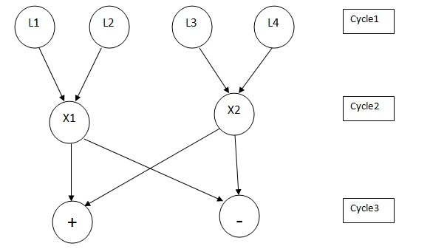
Software and Hardware Parallelism

Slide 19
Software and Hardware Parallelism
L1
L2
L3
L4
X1
X2
+
-
C1
C2
C3
C4
C5
C6
C7

Slide 20
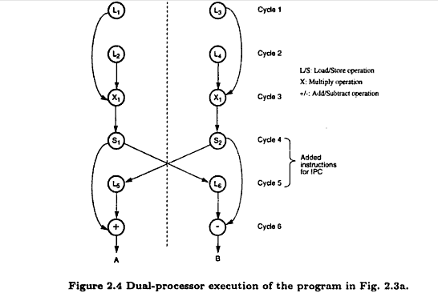
Mismatch between s/w and h/w parallelism

Slide 21
Software parallelism
Control parallelism – allows two or more operations to be performed concurrently
Pipelining, multiple functional units
Data parallelism – almost the same operation is performed over many data elements by many processors concurrently
Code is easier to write and debug

Slide 22
Program Partitioning & Scheduling

Slide 23
Grain sizes and latency
Granularity is a measure of the amount of computation involved in a software process
Count the number of instructions in a segment
Fine, medium, or coarse
Latency is a time measure of the communication overhead
Memory or synchronization latency

Slide 24
Levels of parallelism
Instruction level (fine)
Loop level (fine)
Procedure level (medium)
Subprogram level (medium to coarse)
Job or program level (coarse)

Slide 25
Communication latency
Latency imposes a limiting factor on the scalability of the machine size
Memory Latency Increase with respect to memory capacity.
Communication patterns are determined by the algorithms used and by the architectural support provided
Permutations, broadcast, multicast, and conference

Slide 26
Grain packing and scheduling
The grain size problem requires determination of both the number of partitions and the size of grains in a parallel problem
Solution is problem dependent and machine dependent
Want a short schedule for fast execution of subdivided program modules

Slide 27
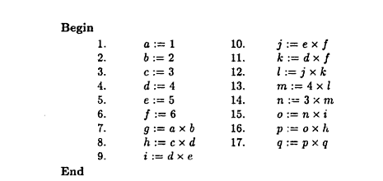
Grain packing and scheduling

Slide 28
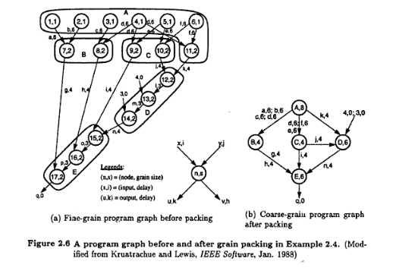
Grain packing and scheduling

Slide 29
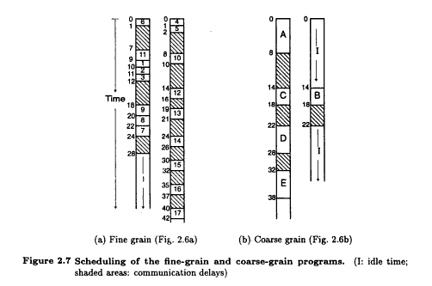
Grain packing and scheduling

Slide 30
Static multiprocessor scheduling
Grain packing may not be optimal
Dynamic multiprocessor scheduling is an NP-hard problem
Node duplication is a static scheme for multiprocessor scheduling

Slide 31
Node duplication
Duplicate some nodes to eliminate idle time and reduce communication delays
Grain packing and node duplication are often used jointly to determine the best grain size and corresponding schedule

Slide 32
Schedule without node duplication
P1
P2
P1
P2
A,4
4
A
I
4
a,1
a,8
6
B
B,1
C,1
I
c,1
13
12
c,8
C
14
b,1
E
D,2
E,2
16
21
20
D
23
d,4
e,4
27

Slide 33
Schedule with node duplication
P1
P2
P1
P2
A,4
A’,4
4
A
A
4
a,1
a,1
a,1
6
B
C
6
B,1
C’,1
C,1
7
C
c,1
E
b,1
c,1
9
10
D
D,2
E,2
13
14

Slide 34
Grain determination and scheduling optimization
Step 1: Construct a fine-grain program graph
Step 2: Schedule the fine-grain computation
Step 3: Grain packing to produce coarse grains
Step 4: Generate a parallel schedule based on
the packed graph

Slide 35
Program Flow Mechanisms
Control Flow Computers
Data Flow Computers
Demand Driven Computers

Slide 36
Control Flow Computers
Use shared memory to hold program instructions and data
Are inherently sequential due to the control-driven mechanism
Can be made parallel by using parallel language constructs and parallel compilers

Slide 37
Dataflow Computers
Data availability drives the execution of instructions
Data tokens are passed directly between instructions
No shared memory, program counter or control sequencer

Slide 38
Dataflow Computers (cont.)
Require special mechanisms to detect data availability
Require special mechanism to match data tokens with the instructions that need them
Require special mechanism to enable the chain reaction of asynchronous instruction executions.

Slide 39
Demand Driven Computers (Reduction Computers)
The computation is triggered by the demand for an operation’s result
It uses a top-down approach
Instructions are executed only when other instructions need their results

Slide 40
Reduction Computers Models
String Reduction Model: Each demander gets a separate copy of the expression for its own evaluation. A long string expression is reduced to a single value in a recursive fashion.
Graph Reduction Model: The expression is represented as a directed graph.The graph is reduced by evaluation of branches or subgraphs.

Slide 41
System Interconnect Architecture
Static and dynamic networks for interconnecting computer subsystems or for constructing multiprocessors or multicomputers
Ideal: Construct a low-latency network with a high data transfer rate

Slide 42
Network Properties and Routing
Static Networks: Point-to-Point direct connections which will not change during program execution
Dynamic Networks: Implemented with switched channels. They are dynamically configured to match the communication demand in user programs

Slide 43
Network Parameters
Network size: The number of nodes in the graph used to represent the network
Node Degree d: The number of edges incident to a node. Sum of in degree and out degree
Network Diameter D: The maximum shortest path between any two nodes

Slide 44
Network Parameters (cont.)
Bisection Width:
Channel bisection width b: The minimum number of edges along the cut that divides the network in two equal halves
Each channel has w bit wires
Wire bisection width: B=b*w; B is the wiring density of the network. It provides a good indicator of tha max communication bandwidth along the bisection of the network

Slide 45
Network Parameters (cont.)
Data Routing Functions: used for inter-PE data exchange. They can be static or dynamic
Common Data Routing Functions:
Shifting
Rotation
Permutation (one-to-one)
Broadcast (one-to-many)
Multicast (many-to-many)
Personalized Communication (one-to-many)
Shuffle
Exchange

Slide 46
Permutations
For n objects there are n! permutations by which the n objects can be reordered.The set of all permutations form a permutation group with respect to a composition operation. Cycle notation can be used to specify a permutation operation.
Permutation π = (a, b, c)(d, e) means: a->b, b->c, c->a, d->e and e->d in a circular fashion. The cycle (a, b, c) has a period of 3, and the cycle (d, e) has a period of 2. π will have a period equal to 2 x 3 = 6.

Slide 47
Permutations (cont.)
Can be implemented using crossbar switches, multistage networks or with shifting or broadcast operations.
Permutation capability is an indication of network’s data routing capabilities

Slide 48
Perfect Shuffle
Special permutation function
n = 2^{k} objects; each object representation requires k bits
Perfect shuffle maps x to y where:
x = ( x_{k-1}, …, x₁, x₀ )
y = ( x_{k-2}, …, x₁, x₀, x_{k-1} )

Slide 49
Exchange
n = 2^{k} objects; each object representation requires k bits
The exchange maps x to y where:
x = ( x_{k-1}, …, x₁, x₀ )
y = ( x_{k-1}, …, x₁, x₀’ )
Hypercube routing functions are exchanges

Slide 50
Broadcast and Multicast
Broadcast: One-to-all mapping
Multicast: one subset to another subset
Personalized Broadcast: Personalized messages to only selected receivers

Slide 51
Network Performance
Functionality
Network latency
Bandwidth
Hardware complexity
Scalability

Slide 52
Static Connection Networks
Linear Array
Ring and Chordal Ring
Barrel Shifter
Tree and Star
Fat tree
Mesh and Torus
Systolic Arrays
Hypercubes
Cube connected cycles
k-ary n-Cube networks

Slide 53
Dynamic Connection Networks
Digital Buses
Switch modules
Multistage networks
Omega Network
Crossbar Networks

